Slide 1
"Resource Management with Deep Reinforcement Learning"
의 재현에 관해
이현성

Slide 2
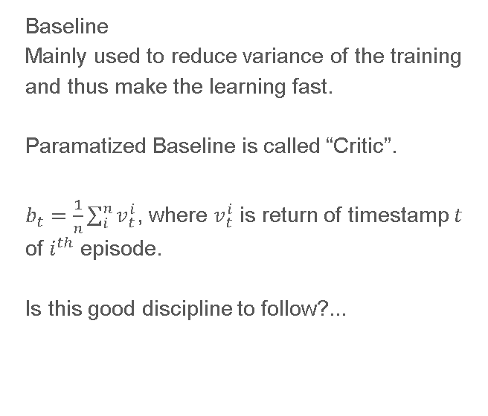
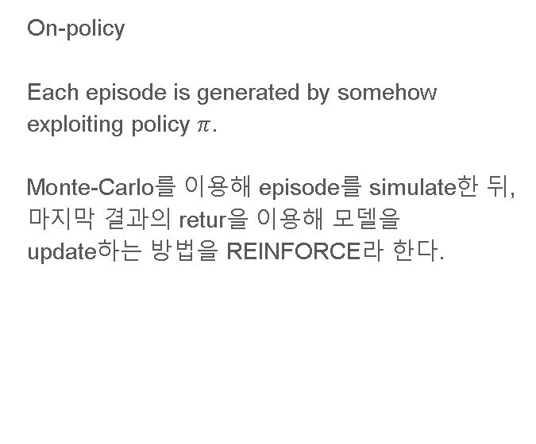
On-Policy Monte-Carlo Policy Gradient with Baseline
On-policy
Each episode is generated by somehow exploiting policy $π$.
Monte-Carlo를 이용해 episode를 simulate한 뒤, 마지막 결과의 retur을 이용해 모델을 update하는 방법을 REINFORCE라 한다.
Baseline
Mainly used to reduce variance of the training and thus make the learning fast.
Paramatized Baseline is called “Critic”.
$b_{t}=\frac{1}{n}\sum_{i}^{n}{v_{t}^{i}}$, where $v_{t}^{i}$ is return of timestamp $t$ of $i^{th}$ episode.
Is this good discipline to follow?...

Slide 3
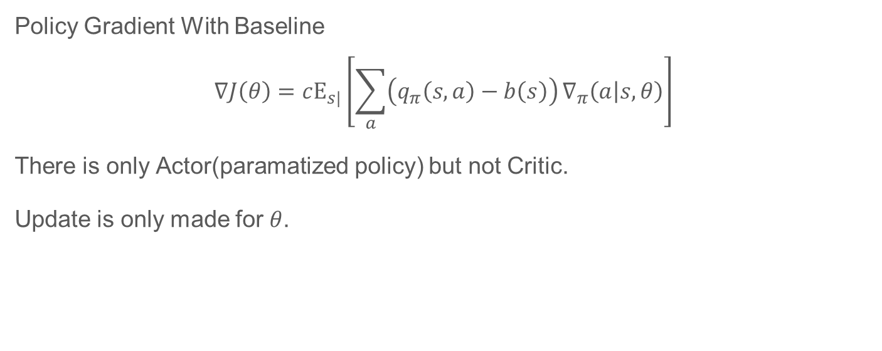
REINFORCE with Baseline
Policy Gradient With Baseline
$$∇J\left(θ\right)=cΕ_{s|}\left[\sum_{a}{\left(q_{π}\left(s,a\right)−b\left(s\right)\right)}∇_{π}\left(a | s,θ\right)\right]$$
There is only Actor(paramatized policy) but not Critic.
Update is only made for $θ$.

Slide 4
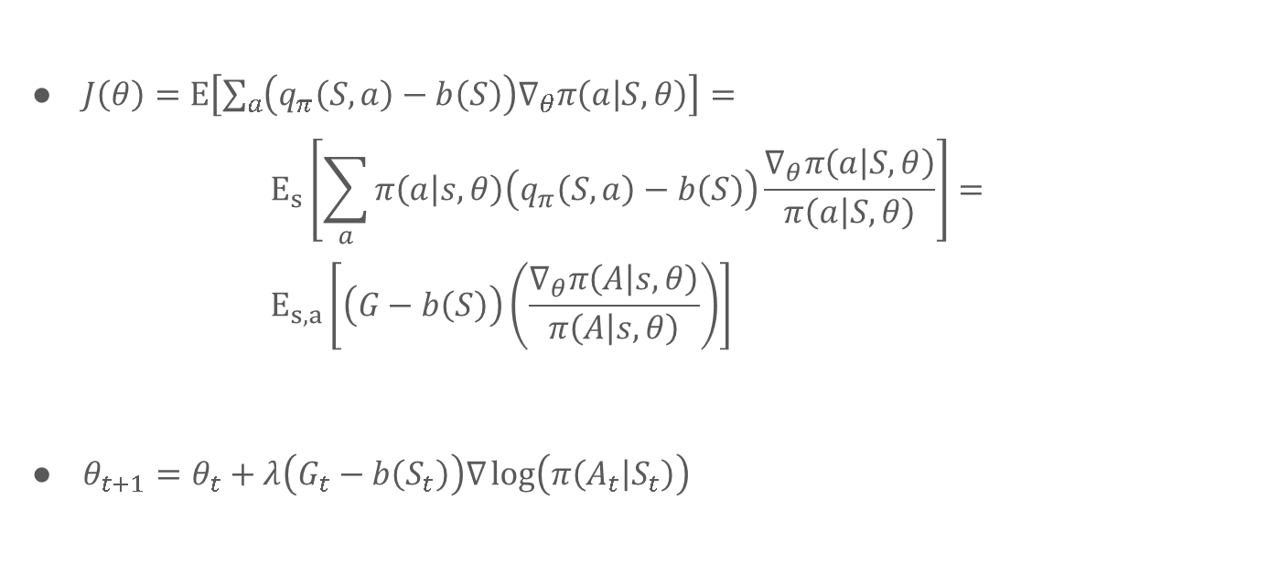
REINFORCE with Baseline
$J\left(θ\right)=Ε\left[\sum_{a}{\left(q_{π}\left(S,a\right)−b\left(S\right)\right)∇_{θ}π\left(a | S,θ\right)}\right]=$ $E_{s}\left[\sum_{a}{π\left(a | s,θ\right)\left(q_{π}\left(S,a\right)−b\left(S\right)\right)\frac{∇_{θ}π\left(a | S,θ\right)}{π\left(a | S,θ\right)}}\right]=$ $E_{s,a}\left[\left(G−b\left(S\right)\right)\left(\frac{∇_{θ}π\left(A | s,θ\right)}{π\left(A | s,θ\right)}\right)\right]$
$θ_{t+1}=θ_{t}+λ\left(G_{t}−b\left(S_{t}\right)\right)∇\log\left(π\left(A_{t} | S_{t}\right)\right)$

Slide 5
REINFORCE with Baseline

Slide 6
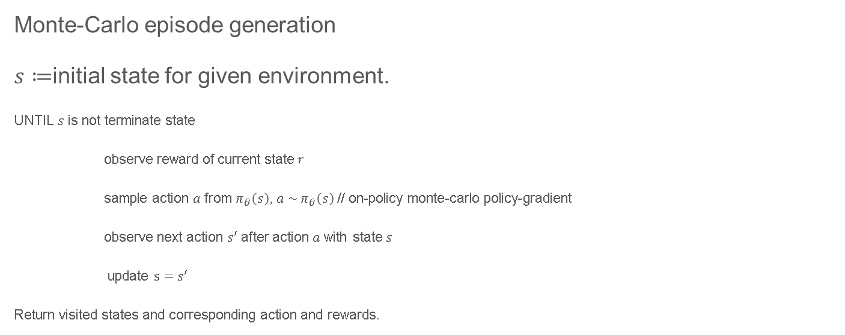
On-Policy Monte-Carlo Policy Gradient with Baseline
Monte-Carlo episode generation
$s≔$initial state for given environment.
UNTIL $s$ is not terminate state
observe reward of current state $r$
sample action $a$ from $π_{θ}\left(s\right)$, $a \sim π_{θ}\left(s\right)$ // on-policy monte-carlo policy-gradient
observe next action $s′$ after action $a$ with state $s$
update $s=s′$
Return visited states and corresponding action and rewards.

Slide 7
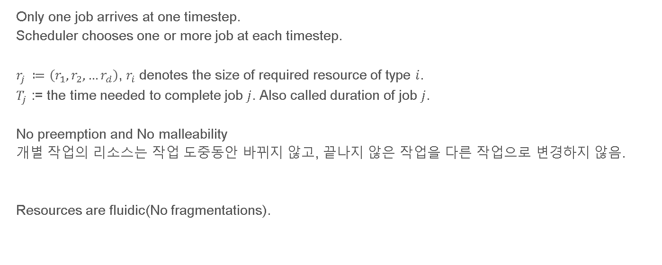
Environment Formulation
Only one job arrives at one timestep.
Scheduler chooses one or more job at each timestep.
$r_{j} ≔\left(r_{1},r_{2},…r_{d}\right)$, $r_{i}$ denotes the size of required resource of type $i$.
$T_{j}$ := the time needed to complete job $j$. Also called duration of job $j$.
No preemption and No malleability
개별 작업의 리소스는 작업 도중동안 바뀌지 않고, 끝나지 않은 작업을 다른 작업으로 변경하지 않음.
Resources are fluidic(No fragmentations).

Slide 8
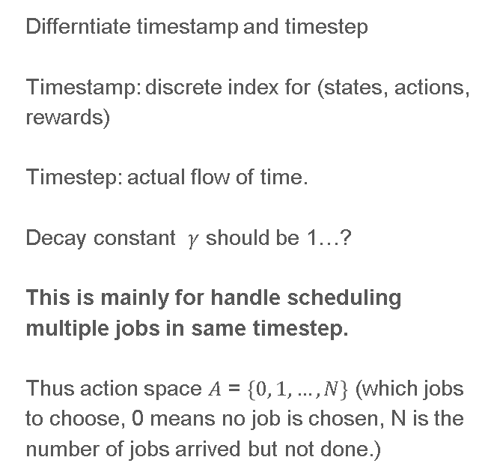
Action formulation
Differntiate timestamp and timestep
Timestamp: discrete index for (states, actions, rewards)
Timestep: actual flow of time.
Decay constant $γ$ should be 1…?
This is mainly for handle scheduling multiple jobs in same timestep.
Thus action space $A$ = $\left\{0, 1, …, N\right\}$ (which jobs to choose, 0 means no job is chosen, N is the number of jobs arrived but not done.)
Arrival of job 1
Arrival of job 2
Arrival of job 3
0ms 100ms 200ms 300ms 400ms
Timestamp 5
(completion of job 1)
Timestamp 1
(Arrival of job 1)
Timestamp 6
(chose to do job 2)
Timestamp 0
Timestamp 2
(chose to do job 1)
Timestamp 3
(Arrival of job 2)
Timestamp 4
(Arrival of job3)
Timestamp 6
(chose to do job 3)
0ms 100ms 200ms 300ms 350ms 400ms
Each timesteps are 50ms.

Slide 9
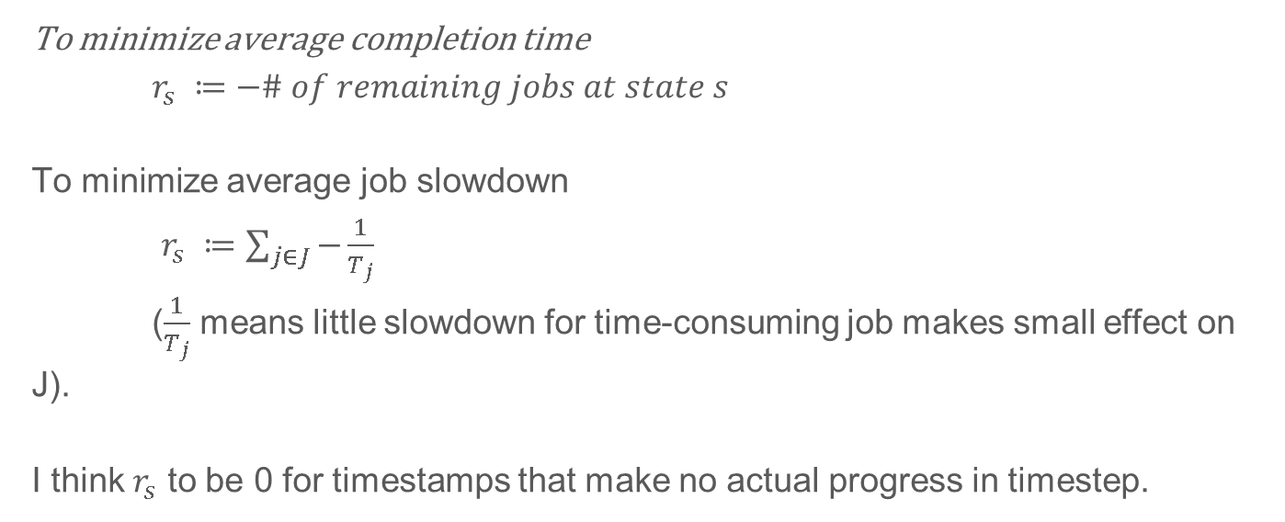
Reward formulation
To minimize average completion time
$r_{s} ≔−\# of remaining jobs at state s$
To minimize average job slowdown
$r_{s} ≔\sum_{j∈J}{−\frac{1}{T_{j}}}$
($\frac{1}{T_{j}}$ means little slowdown for time-consuming job makes small effect on J).
I think $r_{s}$ to be 0 for timestamps that make no actual progress in timestep.

Slide 10
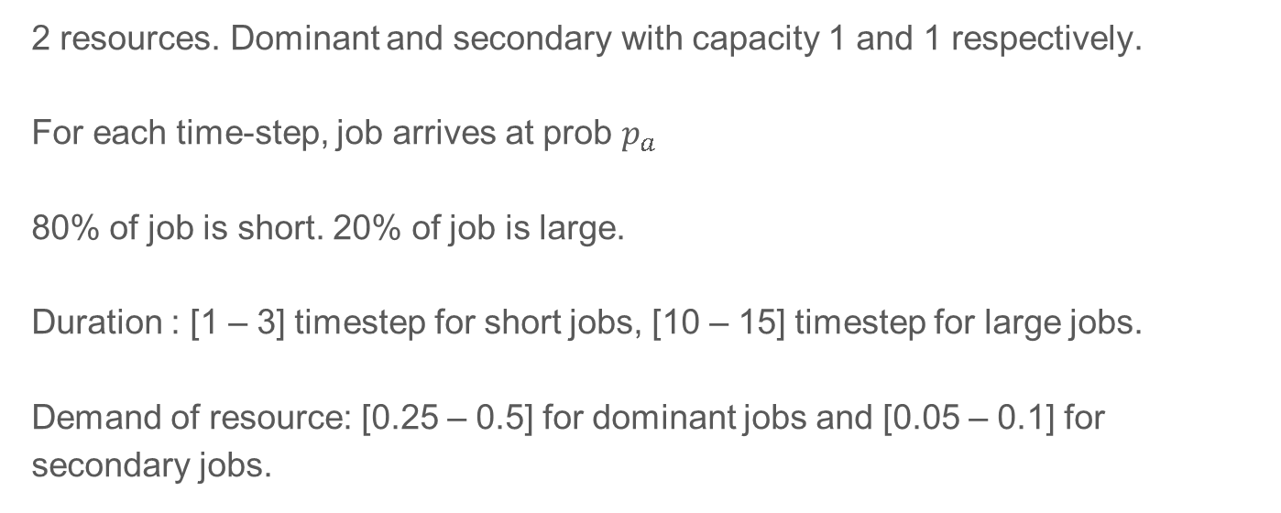
Simulation of job arriving and scheduling
2 resources. Dominant and secondary with capacity 1 and 1 respectively.
For each time-step, job arrives at prob $p_{a}$
80% of job is short. 20% of job is large.
Duration : [1 – 3] timestep for short jobs, [10 – 15] timestep for large jobs.
Demand of resource: [0.25 – 0.5] for dominant jobs and [0.05 – 0.1] for secondary jobs.

Slide 11
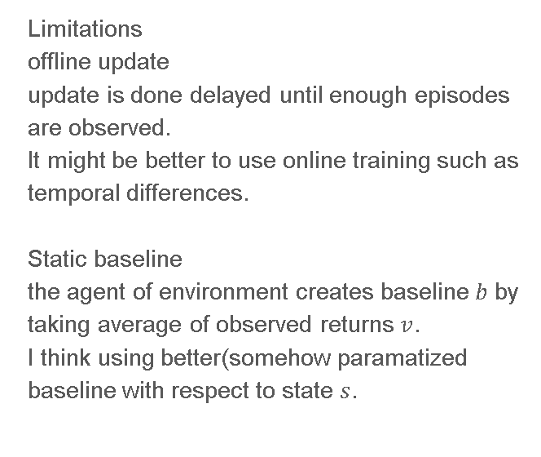
Limitations
Novelties
Limitations
offline update
update is done delayed until enough episodes are observed.
It might be better to use online training such as temporal differences.
Static baseline
the agent of environment creates baseline $b$ by taking average of observed returns $v$.
I think using better(somehow paramatized baseline with respect to state $s$.

Slide 12
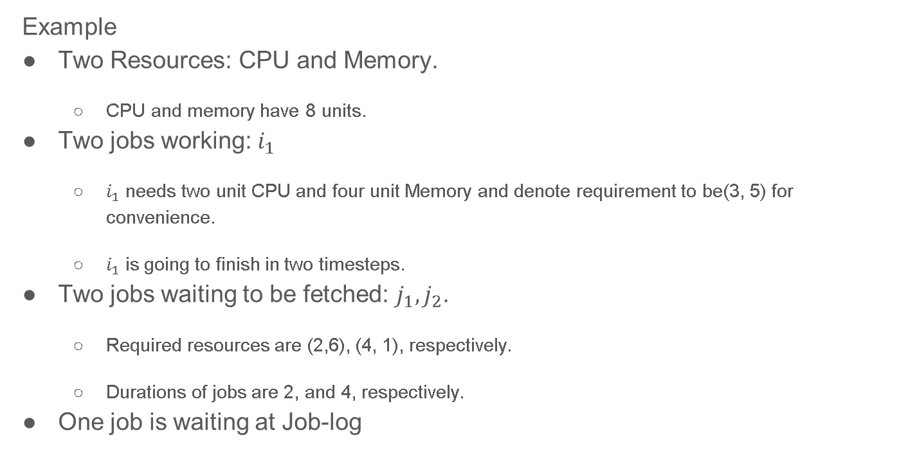
Transform State $S$ into ANN input $x$
Example
Two Resources: CPU and Memory.
CPU and memory have 8 units.
Two jobs working: $i_{1}$
$i_{1}$ needs two unit CPU and four unit Memory and denote requirement to be(3, 5) for convenience.
$i_{1}$ is going to finish in two timesteps.
Two jobs waiting to be fetched: $j_{1},j_{2}$.
Required resources are (2,6), (4, 1), respectively.
Durations of jobs are 2, and 4, respectively.
One job is waiting at Job-log

Slide 13
Transform State $S$ into ANN input $x$
 | Job units |  |  |  |  |  |  |  | Job slot 1 |  |  |  |  |  |  |  | Job slot 2 |  |  |  |  |  |  |  | backlogs
CPU | 1 | 1 | 1 |  |  |  |  |  | 1 | 1 |  |  |  |  |  |  | 1 | 1 | 1 | 1
 | 1 | 1 | 1 |  |  |  |  |  | 1 | 1 |  |  |  |  |  |  | 1 | 1 | 1 | 1
 | 1 | 1 | 1 |  |  |  |  |  |  |  |  |  |  |  |  |  | 1 | 1 | 1 | 1
 |  |  |  |  |  |  |  |  |  |  |  |  |  |  |  |  | 1 | 1 | 1 | 1
 | Job units |  |  |  |  |  |  |  | Job slot 1 |  |  |  |  |  |  |  | Job slot 2 |  |  |  |  |  |  |  | Additional information
Memory | 1 | 1 | 1 | 1 | 1 |  |  |  | 1 | 1 | 1 | 1 | 1 | 1 |  |  | 1
 | 1 | 1 | 1 | 1 | 1 |  |  |  | 1 | 1 | 1 | 1 | 1 | 1 |  |  | 1
 | 1 | 1 | 1 | 1 | 1 |  |  |  |  |  |  |  |  |  |  |  | 1
 |  |  |  |  |  |  |  |  |  |  |  |  |  |  |  |  | 1

Slide 14
Limitations
MLP는 1차원 vector를 input으로 받는다. 2차원으로 표현해도, 어차피 모델이 flatten한다.

Slide 15
Limitations
Two inputs bring different action distribution but they are actually same state.
 | Job units |  |  |  |  |  |  |  | Job slot 1 |  |  |  |  |  |  |  | Job slot 2 |  |  |  |  |  |  |  | backlogs
CPU | 1 | 1 | 1 |  |  |  |  |  | 1 | 1 |  |  |  |  |  |  | 1 | 1 | 1 | 1
 | 1 | 1 | 1 |  |  |  |  |  | 1 | 1 |  |  |  |  |  |  | 1 | 1 | 1 | 1
 | 1 | 1 | 1 |  |  |  |  |  |  |  |  |  |  |  |  |  | 1 | 1 | 1 | 1
 |  |  |  |  |  |  |  |  |  |  |  |  |  |  |  |  | 1 | 1 | 1 | 1
 | Job units |  |  |  |  |  |  |  | Job slot 1 |  |  |  |  |  |  |  | Job slot 2 |  |  |  |  |  |  |  | backlogs
CPU | 1 | 1 | 1 |  |  |  |  |  | 1 | 1 | 1 | 1 |  |  |  |  | 1 | 1
 | 1 | 1 | 1 |  |  |  |  |  | 1 | 1 | 1 | 1 |  |  |  |  | 1 | 1
 | 1 | 1 | 1 |  |  |  |  |  | 1 | 1 | 1 | 1
 |  |  |  |  |  |  |  |  | 1 | 1 | 1 | 1

Slide 16
Limitations
Neural network that handle x[width:width*2] and x[width*2:width*3]… are different. They have same structure. Why split them?
I think it’s better to use shared model for each slots.
Model 0
Cluster
model
input
model
Model for slot
Slot 1
Model for slot
Impelementation is quite easy using RNN with forget=1
Slot 2

